Slide 1

Automated Network Intrusion Detection for Internet of Things: Security Enhancements
An Industrial Oriented mini-project report submitted to JNTUH in the partial fulfilment of the requirements for the award of the degree of
BACHELOR OF TECHNOLOGY
In
COMPUTER SCIENCE AND ENGINEERING
Submitted By
Batch No. - 02
A. VAISHNAVI (21631A0559)
D. ABHIRAM (21631A0502)
M. SAISHASHI (21631A0543)
T. SAI KUMAR (21631A0542)
Under the Esteemed guidance of
Dr. T. Madhu , M. Tech, PhD Associate Professor in CSE Dept.
SRI VENKATESWARA ENGINEERING COLLEGE

Slide 2
TITLE:
Automated Network Intrusion Detection for Internet of Things: Security Enhancements

Slide 3

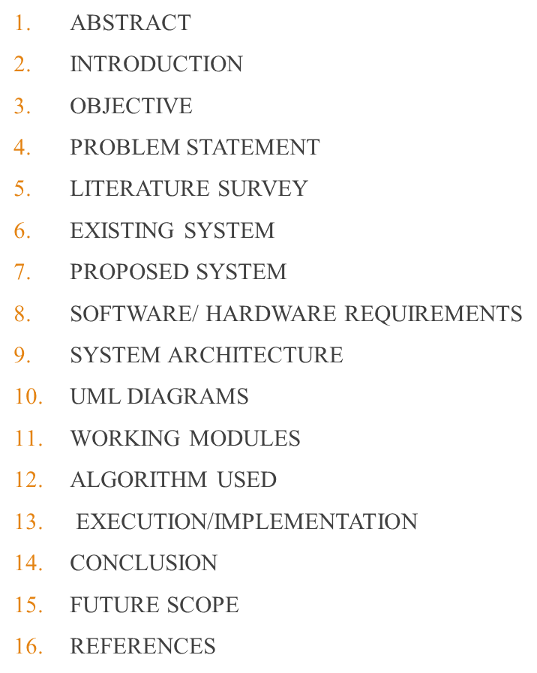

Slide 4
ABSTRACT
Increasing use of the internet and IoT devices has led to more cybersecurity threats, making intrusion detection essential to protect data.
The project introduces an automatic Network Intrusion Detection (NID) system to alert administrators of security breaches in IoT networks.
It uses the Random Forest machine learning model to improve detection accuracy and handle imbalanced data.
The system processes the UNSW-NB15 dataset, balances it with SMOTE, selects important features using PCC, and boosts performance with an ensemble Voting Classifier.

Slide 5
INTRODUCTION
The growth of IoT devices has increased connectivity, but also made network security more complex.
IoT networks carry sensitive data, making them prime targets for cyberattacks and requiring strong security.
Network Intrusion Detection (NID) systems help monitor IoT traffic and detect suspicious activities early.
Machine learning, especially using models like Random Forest, helps NID systems identify threats more accurately.
This project builds a smart NID system using machine learning to better protect IoT networks from cyber threats.

Slide 6
PROBLEM STATEMENT
The fast growth of connected IoT devices brings complex security threats that traditional methods can't handle.
Existing intrusion detection systems often give too many false alarms and struggle with uneven data, especially in IoT networks.
IoT users and administrators risk data loss, privacy issues, and service disruptions due to security breaches.
Attacks can cause financial losses, legal problems, and damage to a company’s reputation, slowing IoT adoption.
To solve these problems, an automated Network Intrusion Detection system using advanced machine learning and smart feature selection is needed to improve accuracy and reduce false alerts.

Slide 7
OBJECTIVE
The main goal is to improve IoT network security using an automated intrusion detection system powered by machine learning.
Random Forest is used as the main model, with a Voting Classifier added to boost accuracy and reliability.
The system aims to detect and classify network traffic into six types: DoS, Exploits, Fuzzers, Generic, Reconnaissance, and Normal.
It will be tested using accuracy, precision, recall, and F1-score to ensure it works well with few false alarms.
The system is designed to help security experts and IoT admins protect networks from cyberattacks.

Slide 8
Literature Survey
Title | Author | Methodology | Drawbacks | Result | Link
An improved PIO feature selection algorithm for IoT network intrusion detection system based on ensemble learning | O. Abu Alghanam, W. Almobaideen, M. Saadeh, and O. Adwan | The study proposed LS-PIO, an improved pigeon-inspired optimization algorithm with local search, combined with ensemble learning using one-class classifiers, tested on four benchmark datasets for IoT network intrusion detection. | The approach's complexity may increase computational overhead for real-time applications. Effectiveness depends on the quality of benchmark datasets, and generalization to new datasets or evolving attack patterns may require further tuning. | The LS-PIO and ensemble-based NIDS achieved superior performance across accuracy, F-score, AUC, TPR, and FPR metrics, outperforming state-of-the-art techniques on BoT-IoT, UNSW-NB15, NSL-KDD, and KDDCUP99 datasets. | https://www.sciencedirect.com/science/article/abs/pii/S0957417422017638

Slide 9
Literature Survey
Title | Author | Methodology | Drawbacks | Result | Link
Anomaly based network intrusion detection for IoT attacks using deep learning technique | B. Sharma, L. Sharma, C. Lal, and S. Roy | The study introduced a filter-based feature selection deep neural network (DNN), applied hyperparameter tuning, and addressed class imbalance using generative adversarial networks (GANs) with the UNSW-NB15 IoT attack dataset. | The model's initial accuracy of 84% indicates potential limitations in feature selection or model tuning. Dependency on GANs for synthetic data generation may affect robustness against real-world, evolving attack patterns. | The proposed IDS achieved 91% accuracy with balanced datasets using GAN-generated data, demonstrating improved detection capabilities for minority classes, outperforming the imbalanced dataset results of 84% accuracy. | https://www.sciencedirect.com/science/article/abs/pii/S0045790623000514

Slide 10
Literature Review / Research Gap
To overcome the limitations identified in the literature survey,
This project uses a Random Forest-based automated NIDS to improve detection accuracy.
SMOTE is used to fix class imbalance, making sure all attack types are fairly represented.
Feature selection methods help reduce complexity and make the system more efficient.
A Voting Classifier (Boosted Decision Tree + Bagging Random Forest) with soft voting improves
performance and avoids overfitting.
A Flask-based front-end with user login provides a secure and easy-to-use interface for testing the system.

Slide 11
EXISTING SYSTEM
Existing Network Intrusion Detection Systems (NIDS) for IoT mainly use signature-based or anomaly-based methods. Signature-based systems detect known attacks by matching traffic with predefined patterns but can't identify new threats. Anomaly-based systems look for unusual behavior to catch unknown attacks, but they often produce many false alarms. These systems also have difficulty detecting rare types of attacks due to imbalanced data and usually need high computational power, making them unsuitable for real-time use in IoT devices.
**Disadvantages of the Existing System :
*Signature-based IDS** can't detect new or unknown attacks.
* Anomaly-based IDS** often gives false alarms by mistaking normal activity as threats.
* They miss rare types of attacks because the data is not balanced.
* They need a lot of computing power, so they don’t work well on simple IoT devices.

Slide 12
DISADVANTAGES OF EXISTING SYSTEM
Current systems use limited types of AI models and don’t combine them for better results.
Using one model at a time makes it harder to catch new or changing attacks.
They don’t handle uneven data well, which causes mistakes during real-time detection.
They don’t choose the most useful data, which reduces accuracy in finding threats.

Slide 13
PROPOSED SYSTEM
The proposed system is an automated intrusion detection system using Random Forest (RF) machine learning to improve accuracy in IoT networks.
It uses SMOTE to fix unbalanced data, making sure all types of attacks are detected better.
To make the system faster and more efficient, it selects only the important features using different feature selection methods like Filter, Wrapper, Embedded techniques, and Pearson’s Correlation.
The system is tested on the UNSW-NB15 dataset and shows better accuracy with fewer false alarms.
Overall, it provides a stronger and smarter way to protect IoT devices from cyber threats.

Slide 14
ADVANTAGES OF PROPOSED SYSTEM
Random Forest (RF) improves attack detection by combining many decision trees, making the model more accurate and reliable.
SMOTE creates extra data for rare attacks so that the system treats all types of attacks fairly and doesn’t ignore less common ones.
Feature Selection methods (Filter, Wrapper, Embedded, PCC) remove unnecessary data, making the model faster and more efficient.
Combined Benefit: Using both data balancing and feature selection helps the system avoid mistakes, improve accuracy, and give better results.

Slide 15
EXTENSION
This project uses a Voting Classifier that combines two models—Boosted Decision Tree and Random Forest—to improve detecting attacks. It picks the class with the highest combined chance, which helps with tricky cases.
Using both models reduces mistakes and works better for different types of attacks and unbalanced data.
A simple web page was made with Flask so users can test the system securely by logging in. This makes it easy and safe to use.

Slide 16
EXTENSION
The Voting Classifier combines different models to make better and more accurate intrusion detection.
It uses Random Forest and Boosted Decision Tree to learn many types of attacks, including rare ones.
This approach helps avoid overfitting and keeps predictions steady.
Soft voting uses prediction probabilities, helping detect less common attacks in imbalanced data.
5. A Flask-based web interface with login ensures only authorized users can access and test the system.
6. The interface is user-friendly and provides quick results while keeping the system secure.

Slide 17
Software And Hardware Requirements
SOFTWARE REQUIREMENT
1. Application : Anaconda
2. Primary Language : Python
3. Frontend Framework : Flask
4. Back-end Framework : Jupyter Notebook
5. Database : Sqlite3
6. Front-End Technologies : HTML, CSS,
JavaScript and
Bootstrap4
HARDWAR REQUIREMENTS
1. Operating System: Windows only
2. Processor : i5 and above
3. RAM : 8GB and above
4. Hard Disk : 25GB and above

Slide 18
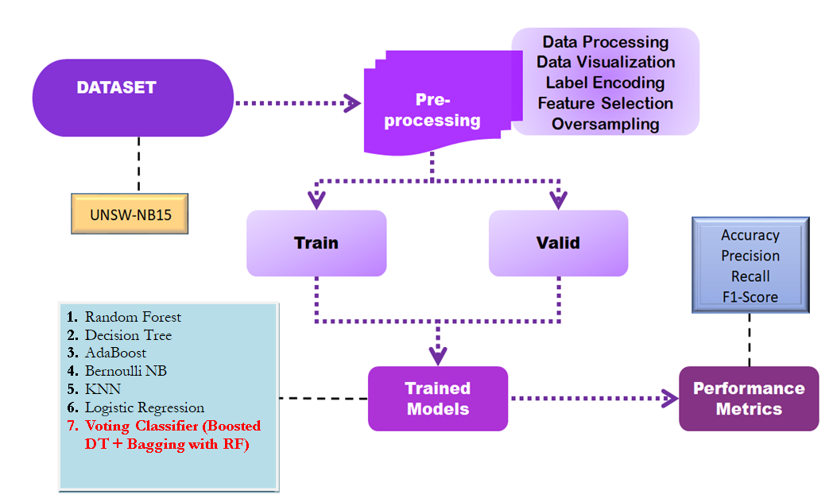
System Architecture

Slide 19
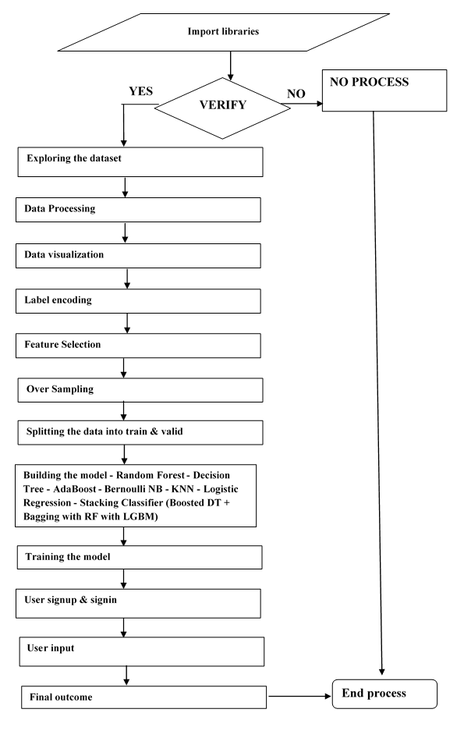
DATA FLOW DIAGRAM

Slide 20
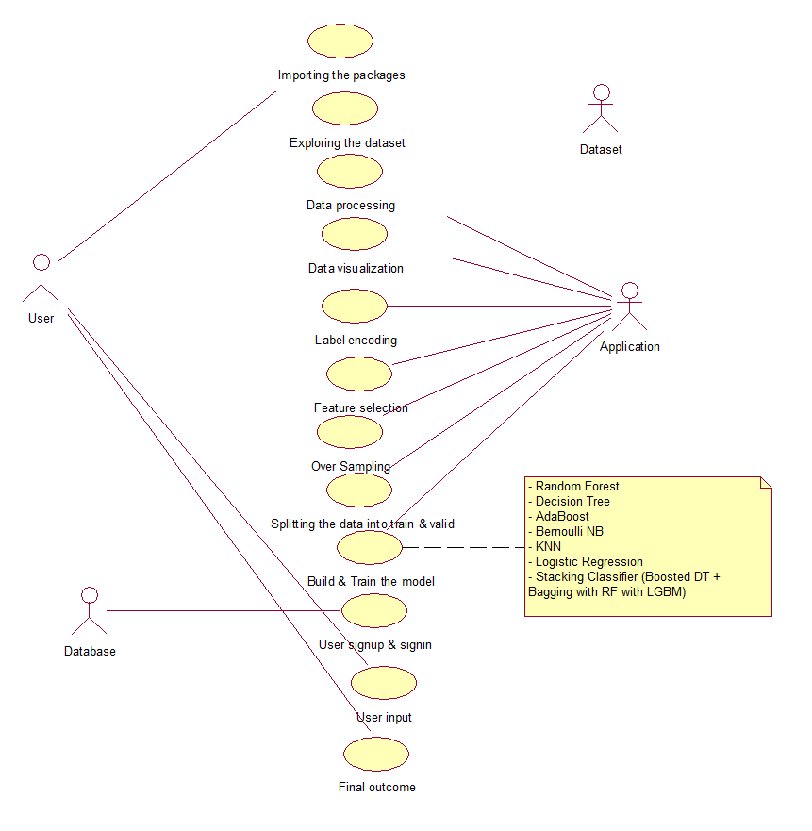
USECASE DIAGRAM

Slide 21
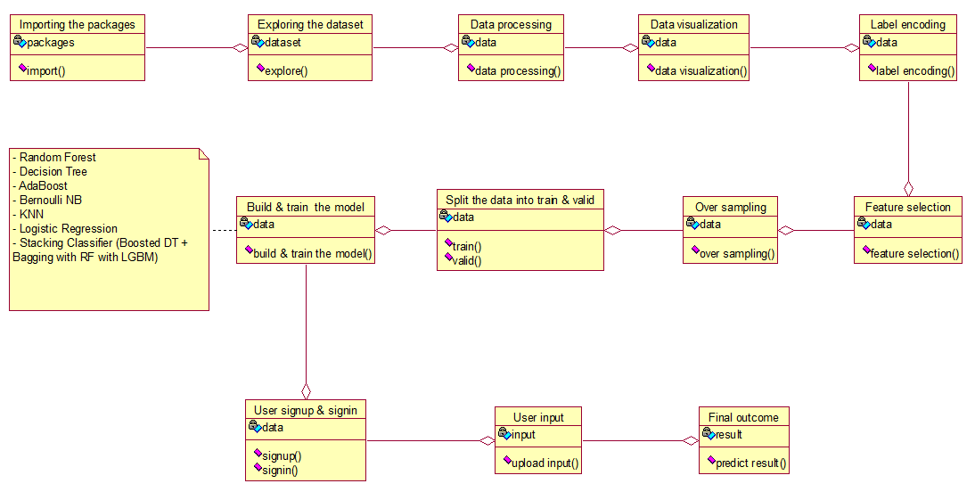
CLASS DIAGRAM

Slide 22
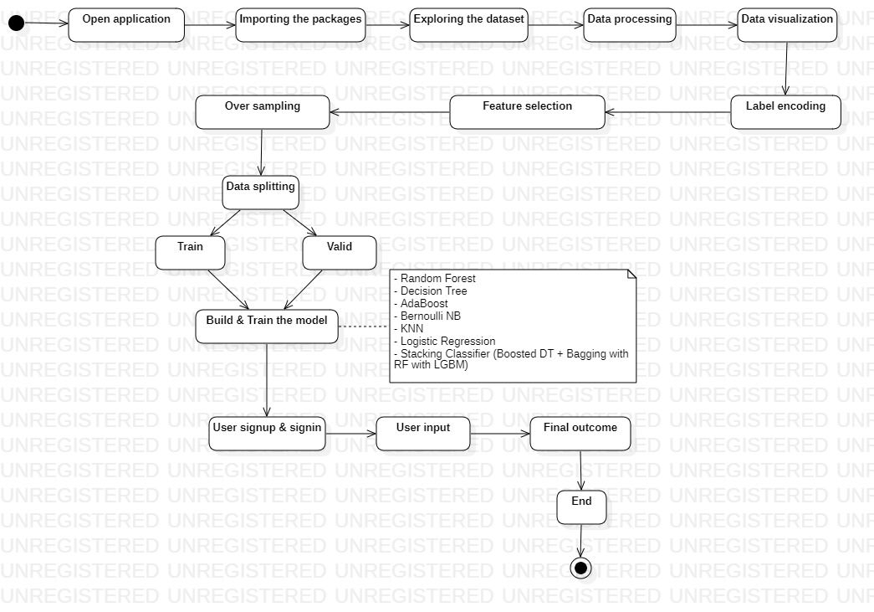
ACTIVITY DIAGRAM

Slide 23
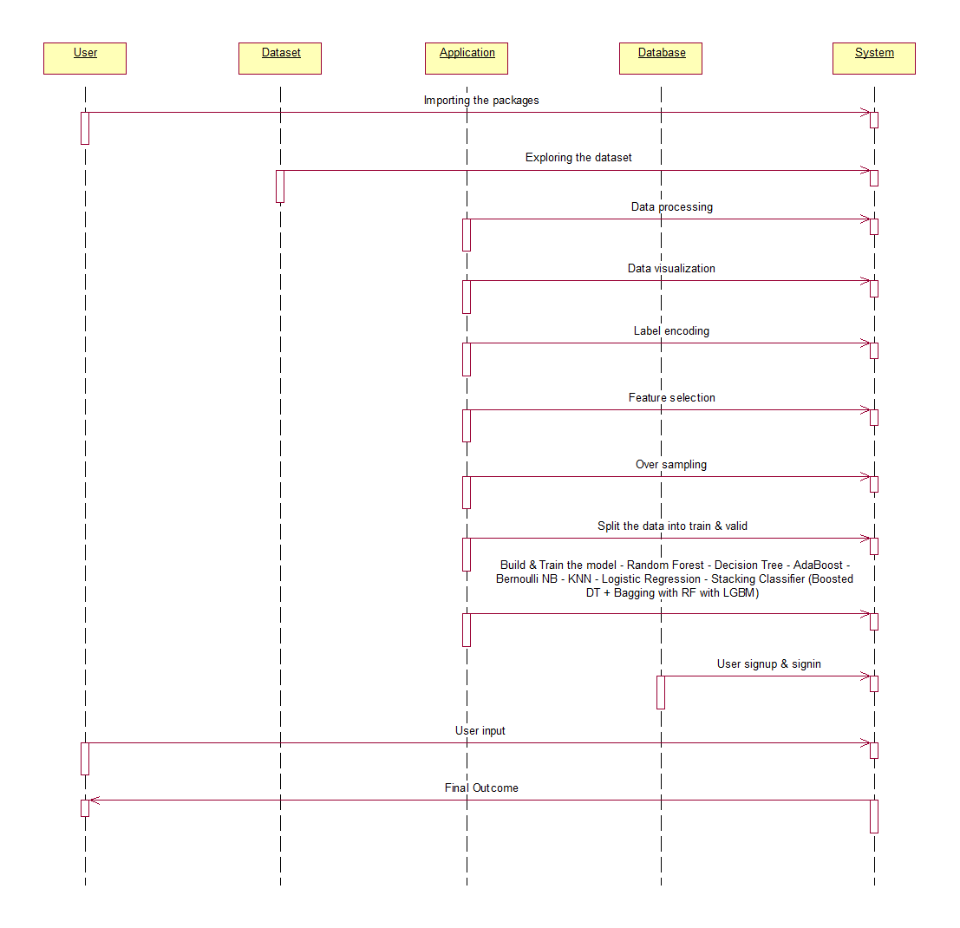
SEQUENECE DIAGRAM

Slide 24
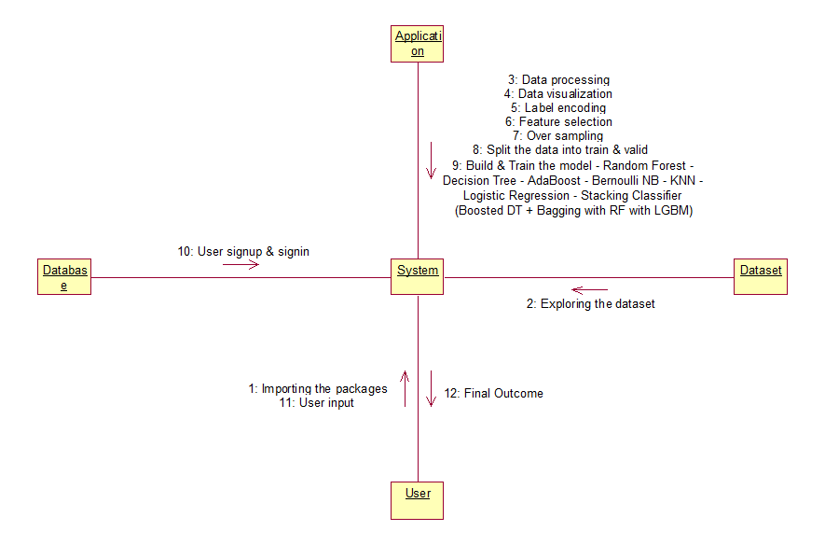
COLLABORATION DIAGRAM

Slide 25
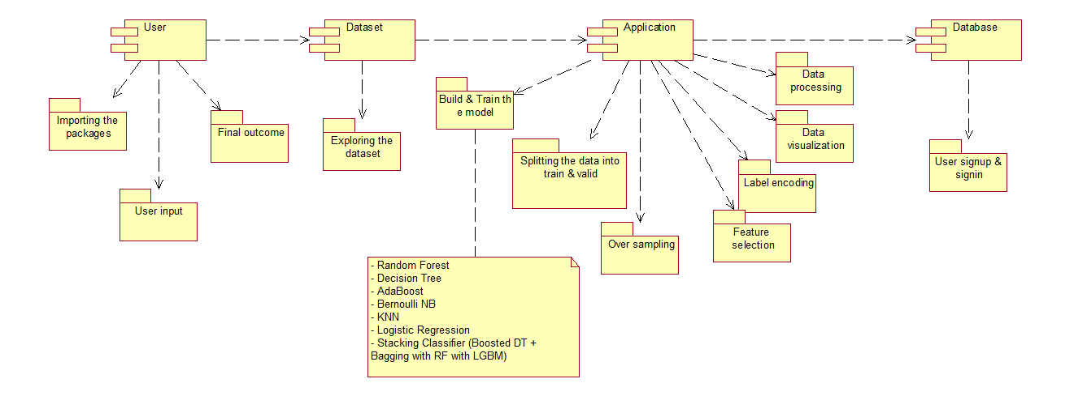
COMPONENT DIAGRAM

Slide 26
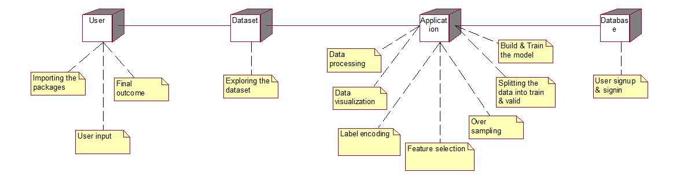
DEPLOYMENT DIAGRAM

Slide 27
FLOW OF WORK /WORKING MODULES
Data Loading: Import the dataset into the system.
Data Processing : Clean the data by removing duplicates, dropping unnecessary parts, and normalizing values to prepare for analysis.
Data Visualization: Use charts and graphs to show patterns and trends in the data clearly.
Label Encoding: Convert text categories into numbers so the model can understand them better.
Feature Selection:Choose the most important features using methods like Filter, Wrapper, and Embedded techniques for better model performance.

Slide 28
FLOW OF WORK /WORKING MODULES
1. Oversampling : Use SMOTE to increase minority class data, balancing the dataset and helping the model detect rare attacks better.
2. Data Splitting : Divide data into training and validation sets.
3. Model Generation: Build different models like Random Forest, Decision Tree, AdaBoost, Bernoulli NB, KNN, Logistic Regression, and a Stacking Classifier combining Boosted DT, Bagging RF, and LGBM. Evaluate their performance.
4. User Signup & Login: Allow users to register and log in.
5. User Input : Let users provide data for prediction.
6. Prediction : Show the final predicted result.

Slide 29
ALGORITHMS USED
Random Forest
Decision Tree
AdaBoost
Bernoulli NB
KNN
Logistic Regression
Voting Classifier (Boosted DT + Bagging with RF)

Slide 30
ALGORITHMS USED
Random Forest
Random Forest is an ensemble learning method that builds multiple decision trees and merges their outputs to improve predictive accuracy and control overfitting. In the context of the automated Network Intrusion Detection system, it is utilized to classify network traffic and identify potential intrusions effectively by analyzing various features and patterns within the data, ensuring robust detection of both known and unknown attacks.
Decision Tree
Decision Tree is a supervised learning algorithm that models decisions using a tree-like structure, splitting data based on feature values to achieve the best outcomes. In the NID system, it aids in making clear, interpretable classifications of network traffic, facilitating the identification of anomalies or intrusions based on specific criteria. Its straightforward nature makes it suitable for rapid decision-making in detecting security threats in IoT environments.

Slide 31
ALGORITHMS USED
AdaBoost
AdaBoost, short for Adaptive Boosting, is an ensemble method that combines weak classifiers to create a strong predictive model. Within the automated NID system, AdaBoost enhances the accuracy of intrusion detection by iteratively improving weak classifiers, focusing on misclassified instances from previous iterations. This approach increases the model's sensitivity to subtle attack patterns, thus enhancing the overall security of IoT networks.
Bernoulli Naive Bayes
Bernoulli Naive Bayes is a probabilistic classifier based on Bayes' theorem, particularly effective for binary features. In the context of the NID system, it is employed to classify network events as benign or malicious based on the presence or absence of certain features. Its simplicity and efficiency make it suitable for real-time intrusion detection, allowing rapid classification and decision-making in IoT environments.

Slide 32
ALGORITHMS USED
K-Nearest Neighbors (KNN)
K-Nearest Neighbors (KNN) is a non-parametric classification algorithm that assigns labels based on the majority class of the nearest neighbors in the feature space. In the automated NID system, KNN is used for anomaly detection, identifying unusual patterns in network traffic by comparing incoming data points with historical data. Its intuitive approach and ability to adapt to varying data distributions make it valuable for detecting potential security threats.
Logistic Regression
Logistic Regression is a statistical method used for binary classification tasks, estimating the probability of a binary outcome based on one or more predictor variables. In the NID system, it helps in assessing the likelihood of a network event being an intrusion, enabling system administrators to prioritize alerts based on risk levels. Its interpretability and efficiency make it a practical choice for modeling relationships in intrusion detection scenarios.

Slide 33
ALGORITHMS USED
Stacking Classifier
The Stacking Classifier is an ensemble learning technique that combines multiple classifiers to improve predictive performance. In the context of the automated NID system, it merges the strengths of classifiers like Boosted Decision Trees, Bagging with Random Forest, and LightGBM to create a robust model. This approach effectively leverages different algorithms' capabilities, enhancing the accuracy and reliability of intrusion detection by providing comprehensive insights from various perspectives within the data.

Slide 34
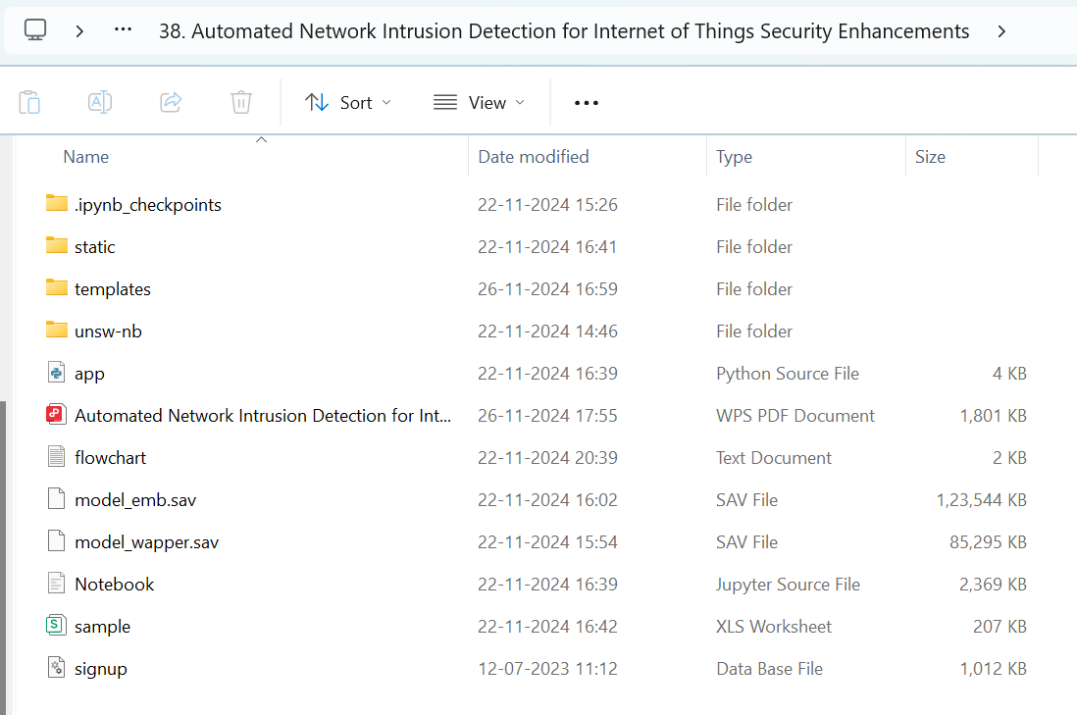
EXECUTION
Step - 1

Slide 35
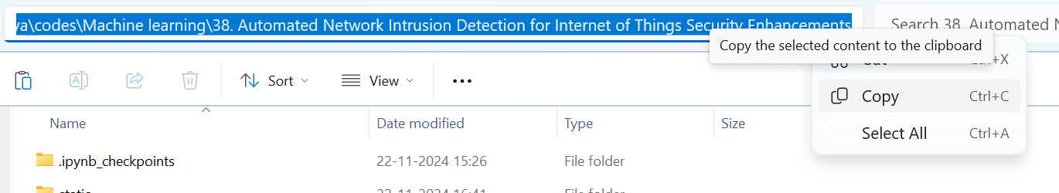
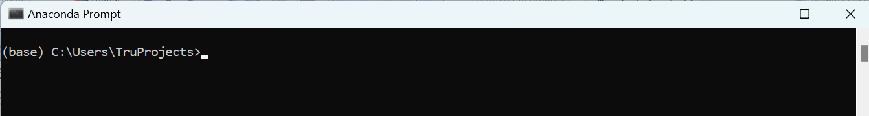
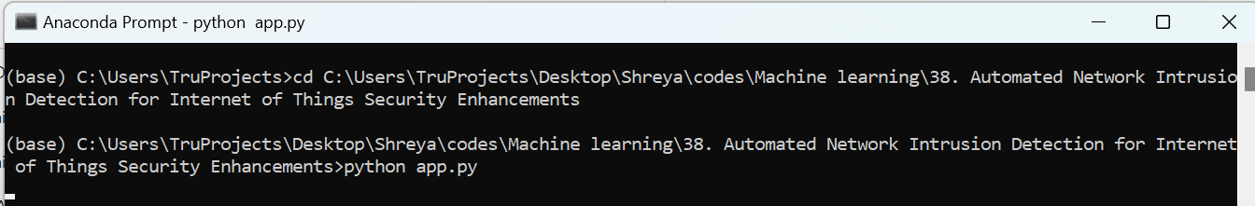
Step - 2
Step - 3
Step - 4

Slide 36
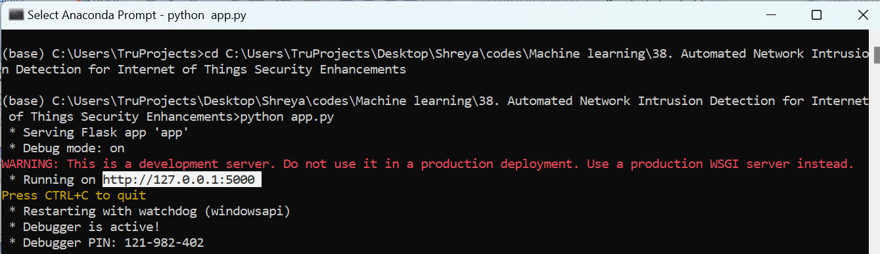
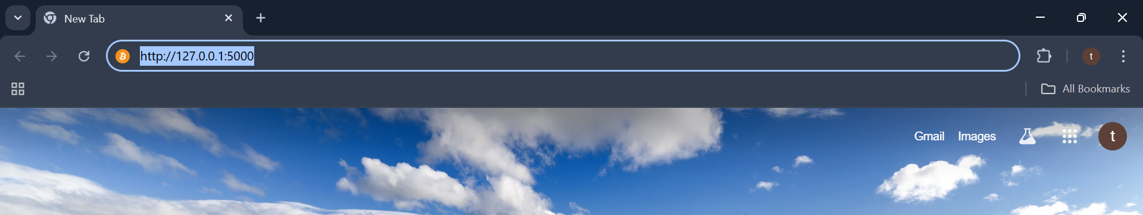
Step -5
Step - 6

Slide 37

User Interface

Slide 38
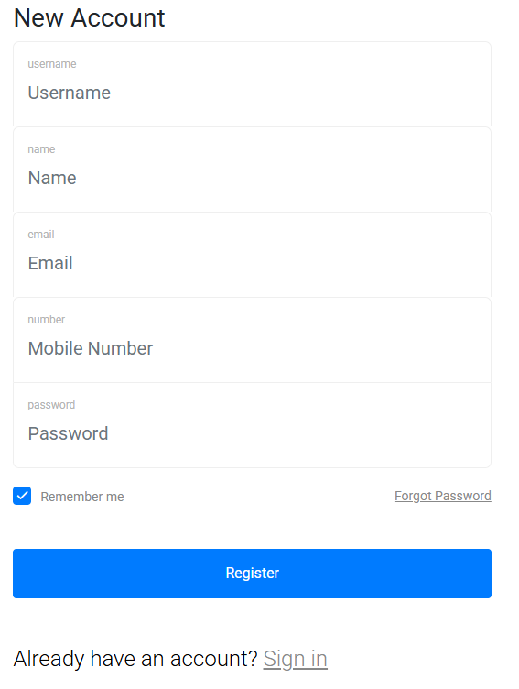
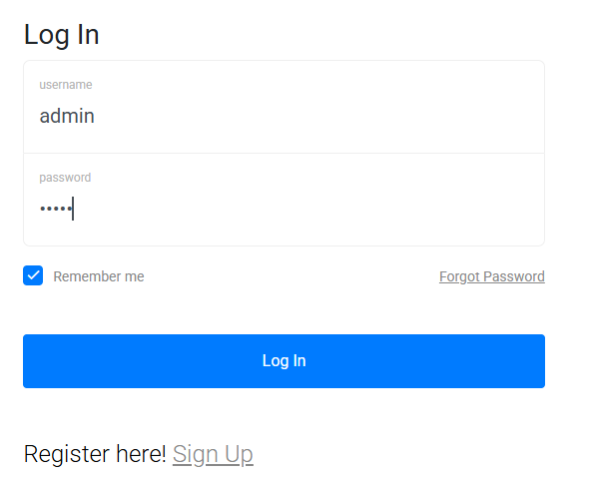
Step - 7
Step - 8

Slide 39

Step - 9

Slide 40
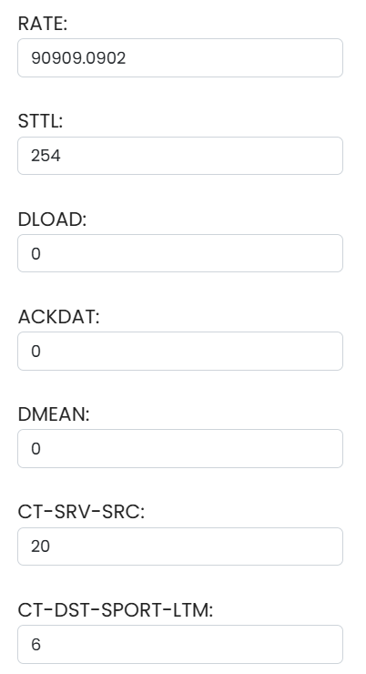
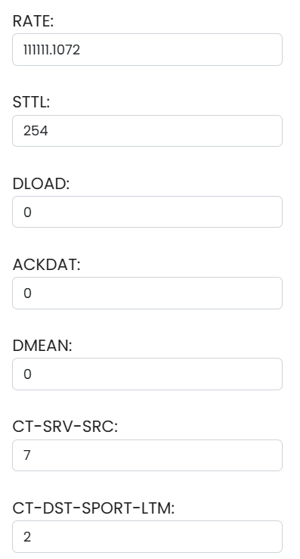
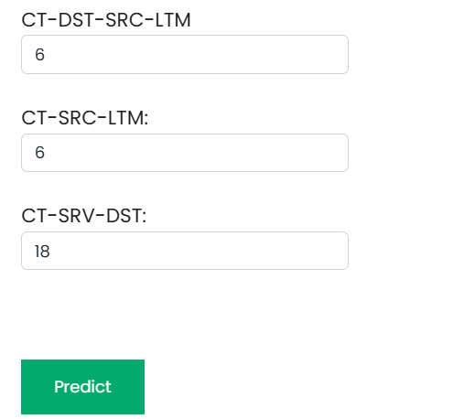
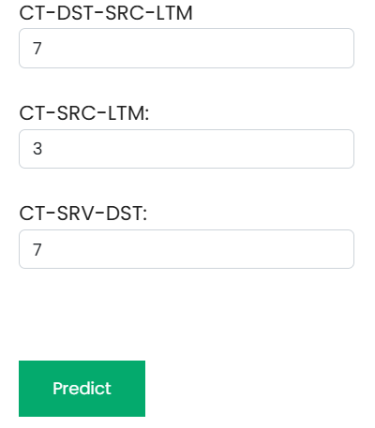

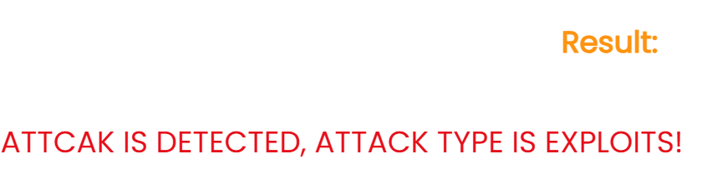
Step – 9
Test case 1
Step – 9
Test case 2

Slide 41
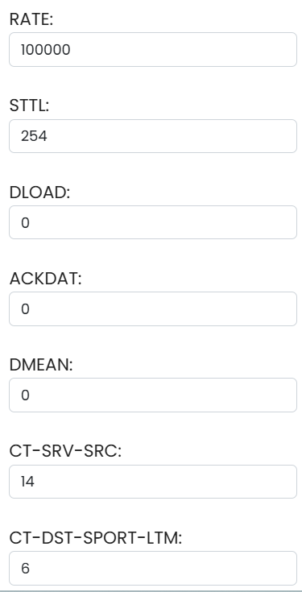
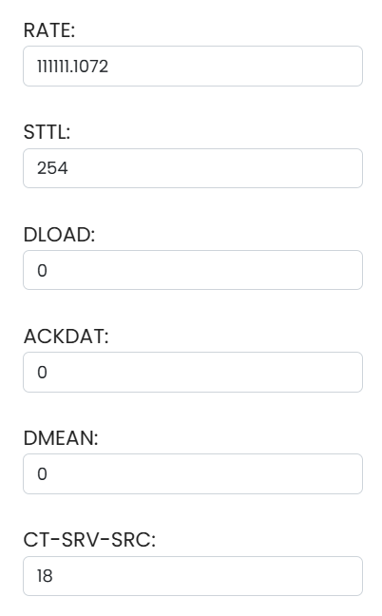
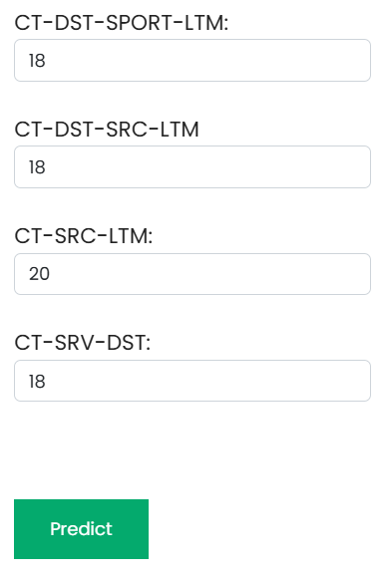
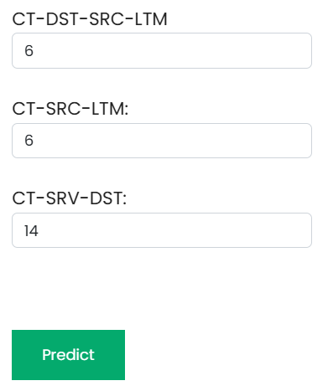


Step – 9
Test case 4
Step – 9
Test case 3

Slide 42
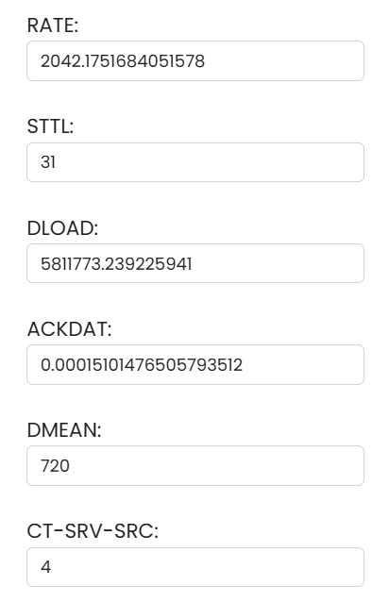
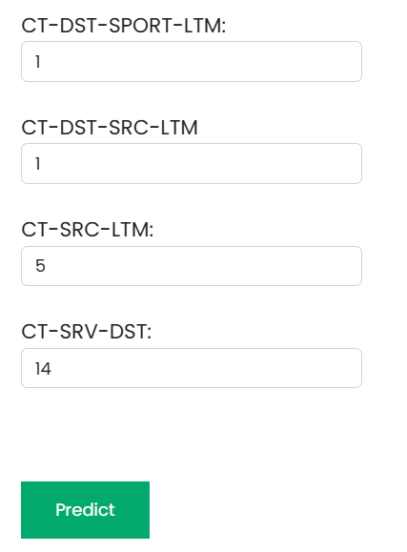

Step – 9
Test case 5

Slide 43
CONCLUISON
The proposed automated Network Intrusion Detection (NID) system addresses key security challenges in IoT environments by ensuring robust protection against evolving cyber threats.
The integration of Filter, Wrapper, and Embedded Methods (Lasso with Random Forest and Recursive Feature Elimination - RFE) enhances dataset quality, improving machine learning model efficiency.
SMOTE (Synthetic Minority Over-sampling Technique) effectively balances the dataset, improving the detection rate of minority attack classes and reducing classification bias.
The Voting Classifier, combining Boosted Decision Trees, Bagging Random Forest, and LightGBM, delivers high detection accuracy and reduces false alarm rates, ensuring reliable intrusion detection.
The system provides a valuable cybersecurity tool, allowing administrators to effectively safeguard IoT networks while maintaining the integrity and confidentiality of sensitive data.

Slide 44
FUTURE SCOPE
Enhancing the system to perform real-time monitoring and automated threat mitigation, enabling proactive responses to network intrusions in IoT environments.
Exploring advanced deep learning techniques, such as CNN, LSTM, or Transformers, to further improve intrusion detection accuracy and adaptability to new attack patterns.
Expanding the system’s capability to handle massive IoT infrastructures, ensuring efficient intrusion detection across diverse network architectures and edge computing environments.
Implementing continuous learning mechanisms where the model updates itself dynamically based on new attack data, improving its ability to detect emerging cyber threats.
Deploying the system in a cloud-based architecture to provide scalable, remote, and centralized security monitoring for IoT networks with minimal hardware dependency.

Slide 45
REFERENCES
O. Abu Alghanam, W. Almobaideen, M. Saadeh, and O. Adwan, ‘‘An improved PIO feature selection algorithm for IoT network intrusion detection system based on ensemble learning,’’ Exp. Syst. Appl., vol. 213, Mar. 2023, Art. no. 118745.
B. Sharma, L. Sharma, C. Lal, and S. Roy, ‘‘Anomaly based network intrusion detection for IoT attacks using deep learning technique,’’ Comput. Electr. Eng., vol. 107, Apr. 2023, Art. no. 108626.
I. Debicha, R. Bauwens, T. Debatty, J.-M. Dricot, T. Kenaza, and W. Mees, ‘‘TAD: Transfer learning-based multi-adversarial detection of evasion attacks against network intrusion detection systems,’’ Future Gener. Comput. Syst., vol. 138, pp. 185–197, Jan. 2023.
W. Wang, S. Jian, Y. Tan, Q. Wu, and C. Huang, ‘‘Robust unsupervised network intrusion detection with self-supervised masked context reconstruction,’’ Comput. Secur., vol. 128, May 2023, Art. no. 103131.
W. D. Xiong, K. L. Luo, and R. Li, ‘‘AIDTF: Adversarial training framework for network intrusion detection,’’ Comput. Secur., vol. 128, May 2023, Art. no. 103141.

